Slide 1





Digital Portfolio
STUDENT NAME: NAGAJOTHI.E
REGISTER NO ANDNMID:asunm1112401111033023
DEPARTMENT: BCA
COLLEGE: L.N. Government College,madras university
1

Slide 2
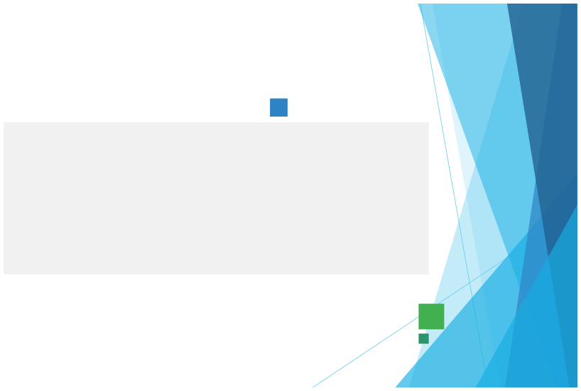
PROJECT TITLE
igital portfolio using front end web development
D
2

Slide 3



AGENDA
1.Problem Statement
2.Project Overview
3.End Users
4. Tools and Technologies
5. Portfolio design and Layout
6.Features and Functionality
7.Results and Screenshots
8.Conclusion
9.Github Link
3/21/2024 AnnualReview
3

Slide 4

PROBLEM STATEMENT
Intoday’s world,traditionalresumes andCVs are no longerenough.Recruiters and clients
want to see real work and practical applications.Students often struggle to present academic projects in a professional format.Job seekers need a platform that goes beyond plain text documents.Many professionals lack a central place to highlight their skills and experience.A digital portfolio solves this gap by combining resumes, projects, and skills in one place.It also offers interactivity with visuals, animations, and structured content.Without a portfolio, opportunities may be lost due to weak first impressions.A modern portfolio can act as a digital
identity card in academic and career growth. This project addresses the need for a personal branding solution
4

Slide 5

PROJECT OVERVIEW
1. 2.
This project is about creating a student digital portfolio website. The portfolio is a professional, structured, and interactive website
3.It begins with a Home section, giving an introduction and call-to-action
4.
The About section highlights career goals, personal details, and passions
5.The Skills section lists technical abilities like HTML, CSS, JavaScript, and Python
5

Slide 6
WHO ARE THE END USERS?
• •
•
•
•
•
Theportfolio isdesignedforawiderange of users
Studentscan useitto showcaseacademic projects,resumes, and
skills Job seekers can share their portfolio links directly with recruiters Instead of long attachments, recruiters can see work live on a website Freelancers can show completed projects to attract clients. It acts as a project gallery, demonstrating creativity and professionalism.Professionals can highlight experience, skills, and a chi evemen ts It helps in building a personal brand for long-term growth End users gain a platform that makes them stand out in competition.
6

Slide 7


TOOLS AND TECHNIQUES
• • • •
•
•
•
•
The portfoliois built usingcore web development tools.
HTML provides the structure of pages and sections. CSS adds styling, colors, layouts, and responsiveness for all devices. JavaScript ensures interactivity such as navigation, animations, and form validation. The project uses modern coding practices for better performance. Code editors like VS Code and CodePen were used for development. The portfolio is hosted on GitHub Pages / Netlify, making it globally a cce ss ib le Responsive techniques ensure it works on mobiles, tablets, and desktops.
Hover effects, smooth scrolling, and animations improve
user experience.
Together, these tools create a functional, attractive, and
professional portfolio
• •
7

Slide 8


POTFOLIO DESIGN AND LAYOUT
The Home section welcomes visitors with a professional intro. The About section shares career goals, skills, and aspirations. The Skills section lists technical knowledge and tools used. The Projects section shows sample works with images and details. Each project card includes titles, descriptions, and live demo links. The Contact section provides a form and clickable links for communication. The design is fully responsive, ensuring accessibility on any screen. Smooth navigation allows visitors to reach sections easily.
The layout creates a balanced mix of professionalism and creativity
• • • • • • • • •
•
The design follows a clean andmodern layout.
8

Slide 9
FEATURES AND FUNCTIONALITY
1. 2. 3. 4. 5. 6. 7. 8. 9.
The portfolio provides easy navigation with a clean interface. Projects are displayed with visual appeal and animations. It creates a memorable first impression for recruiters and clients. Visitors can explore skills, projects, and achievements in one place. The website works on all devices, from laptops to smartphones. The contact form allows direct communication with potential employers. It boosts professional credibility and builds trust with recruiters. Users can share their portfolio link on LinkedIn, email, and resumes. The portfolio gives users a competitive advantage in applications.

Slide 10
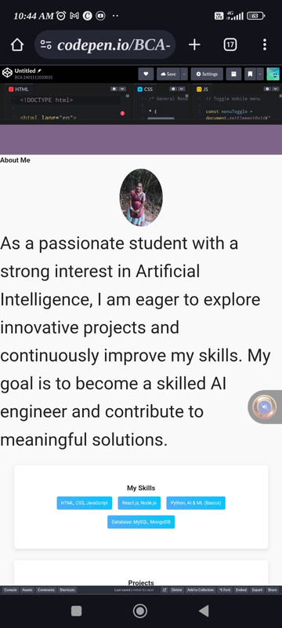
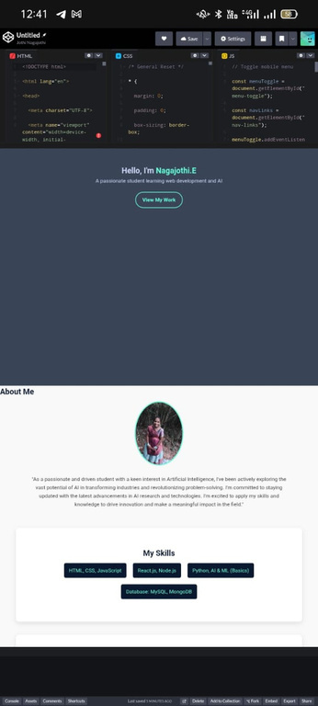

RESULTS AND SCREENSHOTS
3/21/2024 AnnualReview
10

Slide 11
GitHub link
https://bca2401111033023-del.github.io/Myprofile-/
3/21/2024 AnnualReview
10

Slide 12
CONCLUSION
• • • • • • •
•
•
•
A digitalportfolioisamodern replacement for traditional resumes.
It provides an interactive and professional identity. The project demonstrates knowledge of HTML, CSS, and JavaScript. It shows the ability to design and develop responsive websites. The portfolio highlights achievements, skills, and real-world projects It is useful for students, job seekers, freelancers, and professionals. Recruiters and clients gain confidence by seeing actual work samples. The portfolio boosts career opportunities and academic visibility. It leaves a lasting positive impression on potential employers.
In conclusion, a digital portfolio is a gateway to success in the digital
age
11

